Slide 1
Team - The Innovators
Talk-a-Tive (BeReal)
Group Members:
Deepak Katyal
Surendra Tholiya
Rohit Kumar

Slide 2
Summary
Developed an innovative application "talk-a-tive" designed for seamless real-time interaction between multiple nodes(like to IoT devices).
The features that we have implemented in the application are Node Interaction, Authentication and Authorization, Category Creation(Eg: same kind of devices grouped together), Search Functionality.
Generated out own dummy dataset with 1000 nodes and 10000 interactions between nodes with features including attributes like bandwidth, latency, packet_loss, cpu_uses, memory_uses, disk_io and round_trip_time in our dataset.
Added outliers manually to out dataset in order to depict a spike as the randomly generated data had some uneven structure.
Created data visualisation using Power BI depicting the trends of variation in the values of the attributes with-in a range of timestamps denoting change in load on the nodes.

Slide 3
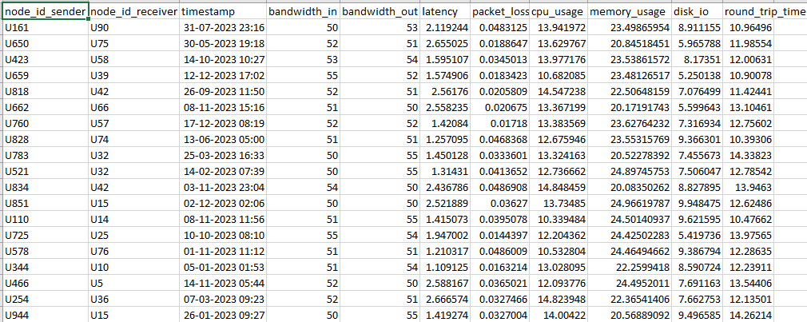
Tools & Technologies Used:
For Web-Application:
Node.js : Express.js is used for backend, authentication system and developing APIs.
MongoDB: Used as a database containing node details and the stories created by the nodes.
Socket.io: For real-time interaction between nodes.
React.js : Used for frontend.
CSS: Used for design part.
For Dataset Generation:
Python: Used python script to generate dummy dataset.
For Data Analysis and Visualization:
PowerBI: Created dashboard using PowerBI for data visualization.

Slide 4
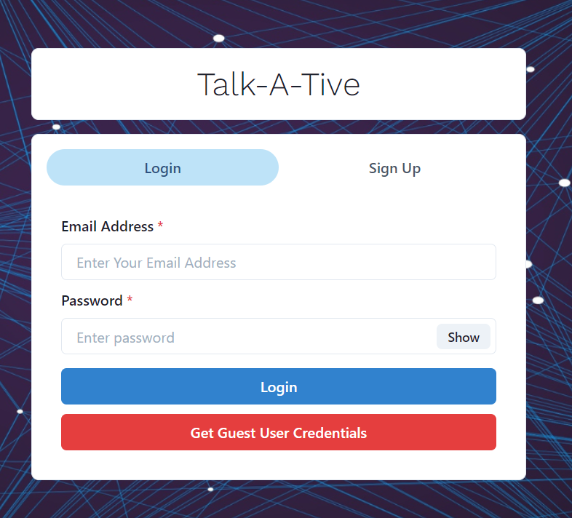
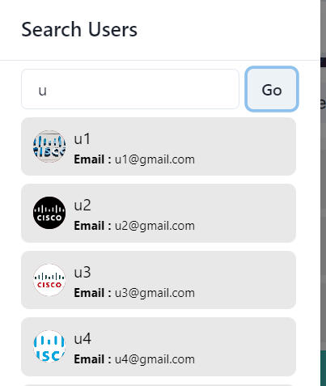
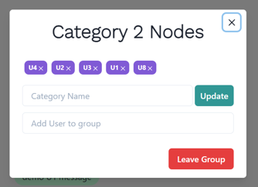
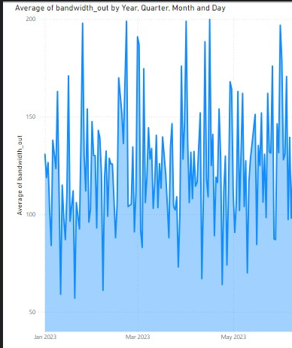
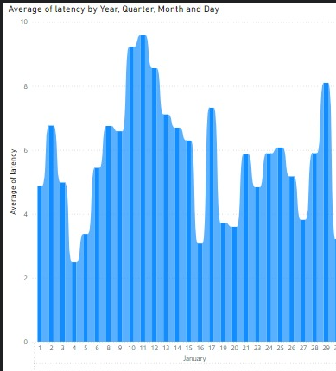
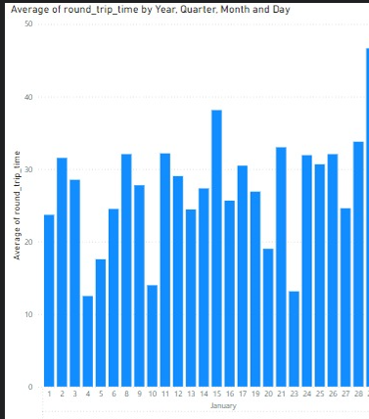
What we have Done ?

Slide 5
Future Scope:
We have implemented user authentication in our application, allowing users to connect with each other. Now, we need to develop an authorization system to manage which users are permitted to connect with others. Users should be able to authorize or revoke authorization for other users to connect with them.
Currently, we are utilizing Power BI for data visualizations. However, in the future, we plan to either continue using Power BI or explore other BI tools that can seamlessly integrate with our application.
Due to insufficient data, we generated random data and added outliers to create useful visualizations. Our plan is to integrate an AI/ML model with a good dataset to identify attributes that degrade network quality and suggest practices to avoid these anomalies. We also aim to focus on specific IoT devices and their unique attributes.

Slide 6
Thank You..!

